Slide 1

FEMININO
BUSINESS PERFORMANCE PROJECT

Slide 2
ABOUT FEMININO
FEMININO is a luxury fashion brand that specializes on the sales of female under wears, nighties, lingerie and other female essentials.
Over the years, FEMININO has grown steadily, expanded into new areas, and has had a growing customer base and active marketing campaigns across multiple channels. Despite the growth, there are some challenges hovering around the business. It has been difficult to identify high value customers due to not having a clear segmentation of customers. There is also limited insights into which channel delivers the highest conversions and ROI.
Therefore, this project seeks to analyze the customer satisfaction and business performance of the brand while pinpointing our most effective marketing channels in order to enhance perfect running or performance of the business.

Slide 3
PROJECT OBJECTIVES
Analyzing the most effective marketing channels driving engagement and conversions, enabling the business to optimize campaigns, improve delivery performance and enhance customer experience.
Evaluating the responsiveness of each marketing channel.
Understanding ordering patterns across customer segments and areas.

Slide 4
DATA CLEANING\EXPLORATORY DATA ANALYSIS
Three tables was merged together, the table consist of Customers, Orders, and Feedback.
Found duplicates from merged table, duplicates was in customer_id_x and customer_id_y; I dropped one variable and renamed the other to customer_id.
328 missing values was recorded in some of the variable; I dropped some of the variables that was not useful and then dropped the missing values in the other variables.
Converted some existing datatype of variable to the appropriate datatype.
Created variables like “Time of Day” , “Revenue”…etc. for my analysis.
Tools used are; Python for Exploratory Data Analysis and Power BI for data visualization.

Slide 5
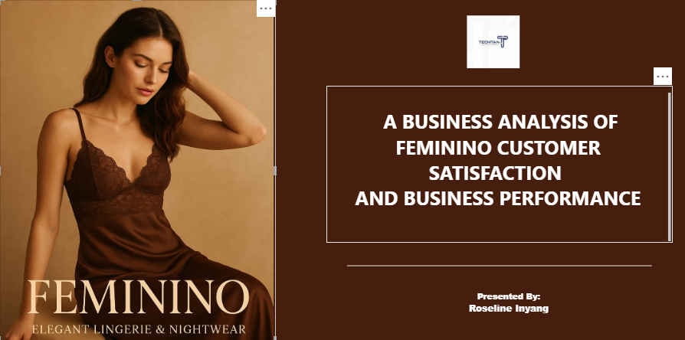

Slide 6
FINDINGS AND INSIGHTS
Question 1:Are there certain areas that needs delivery improvements?
The analysis shows that there are certain areas marked on the map shows that needs delivery improvement recommendation.
Question 2: What product generate the highest revenue?
The product with the highest revenue is BIKINI PANTIES, generating N751,850 followed by matching bra & panties at N611,820
Question 3: Which areas have the highest number of orders ?
UYO has the highest number of orders at 2752, followed by Jos 2,642

Slide 7
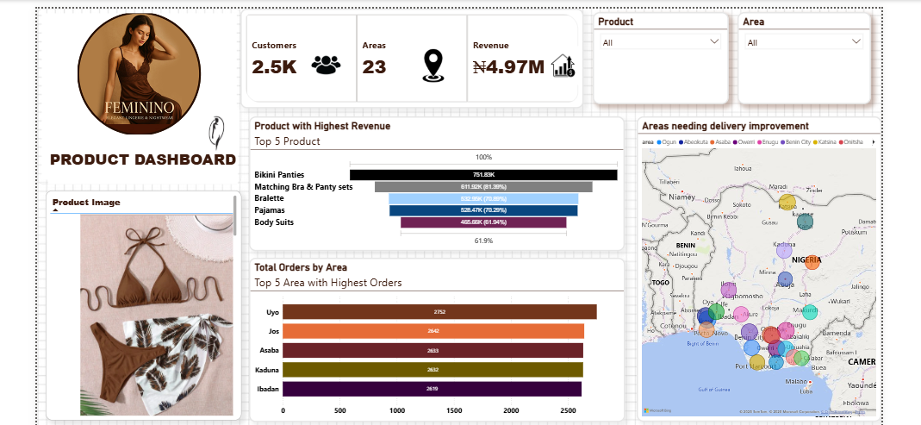

Slide 8
FINDINGS AND INSIGHTS
Question 4:What time of the day do customers make their most order? The NIGHT period has the highest number of orders, significantly surpassing all other time of day. It shows that the majority of customers orders occurs during the NIGHT.
Question 5: What is the most preferred mode of payment? The preferred modes are very evenly spilled among all the four options but MOBILE CARD tops the list.
Question 6: How is the overall business performance overtime?
The trend shows revenue fluctuations, it indicates that while the business maintained consistent growth for most of the period, there was a notable drop towards the end, suggesting possible seasonal or operational challenges.

Slide 9
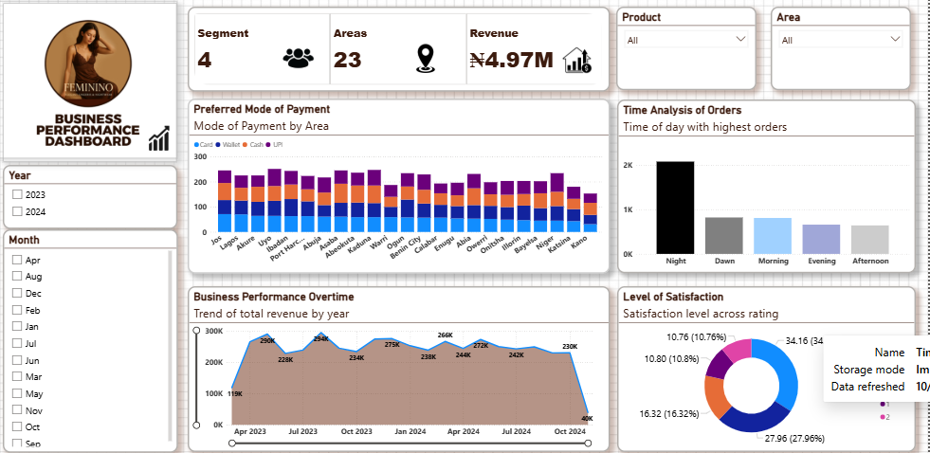

Slide 10
FINDINGS AND INSIGHTS
Question 7: What is the most preferred mode of payment?
The preferred modes are very evenly spilled among all the four options but MOBILE CARD tops the list.
Question 8: Analyze & compare performance across channels(highest conversions)
APP is the highest converting channel with 75,192 conversions. The conversions are highly competitive across the 3 channels indicating a strong performance across digital platforms.
Question 9:What Customer Segment brings in the most revenue or orders more frequently ?
REGULAR customer segment generates the highest number of orders reaching nearly 300,000 followed closely by the NEW segment.
Question 10: The level of satisfaction across ratings
The analysis of customers level of satisfaction by customers based on rating shows that majority of the customers gave their rating review as 4-star(34.16%) followed by 3-star (27.96%).This indicates that while customers generally have a positive perception of the business, there is still room for improvement in achieving higher satisfaction levels. Only 16.32% give 5-star ratings which suggest that customers are moderately satisfied but not fully delighted with their experience.

Slide 11
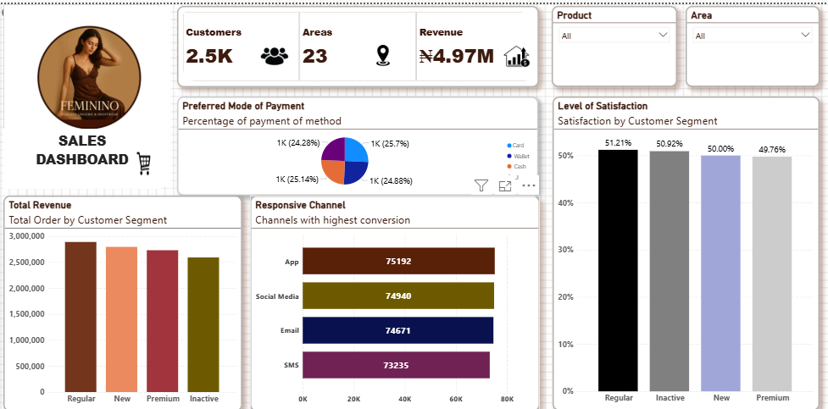

Slide 12
RECOMMENDATIONS
Conduct a survey for the 4-star to know what could been done better to deserve a 5-star rating as well as customers who gave 1-star and 2-star through surveys or follow-ups to understand their pain points and address recurring complaints.
Focus on enhancing customer experience through delivery speed, product quality and support to move customers from 3-4stars to 5-star.
Investigate the reasons for the revenue decline in the last quarter of 2024, this could be due to reduced demand, marketing inactivity, or supply challenges.
Give exclusive discount for the regular segment to lock in repeat purchases and increase their ordering frequency.
Focus on investigating and improving logistics, speed and reliability in the specific locations highlighted on the map.

